Slide 1
Power Screws
Dr. Jacob Moore
Associate Professor of Engineering
Penn State Mont Alto

Slide 2
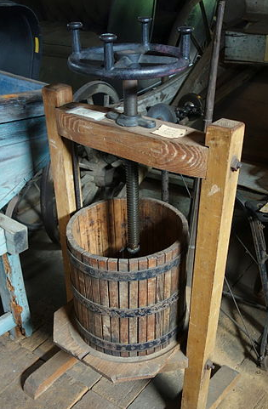
Power Screws
Power screws (also called lead screws) are screws that are used to create very large forces with relatively small torques
They can be thought of as wedges that are compactly wrapped around a shaft, where small input forces are amplified using the geometry of the setup.
Rather than finding the pushing force needed to exert a force or lift a weight, you will often be asked to find the torque or moment needed to exert a force or lift a weight.
Public Domain Image by Daderot

Slide 3
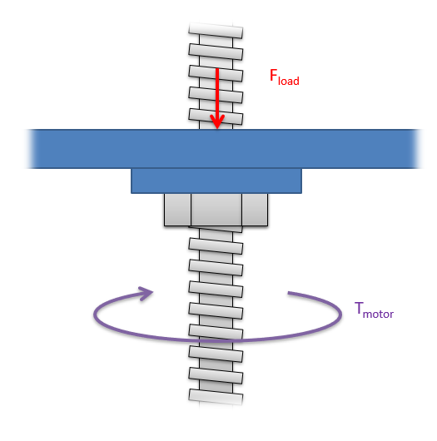




Power Screws and Wedges
If we imagine unwrapping the thread and nut from the shaft, we will have a wedge (representing the nut) being pushed up a long ramp (representing the thread).
$$F_{load}$$
$$F_{push}$$
$$F_{f}$$
$$F_{N}$$

Slide 4
Power Screws and Wedges
One key aspect in analysis is to find the “lead angle” based on the “threads per inch”, or the “pitch”.
nut
thread
1”
lead angle
$$l=π∗shaft diameter∗threads per inch$$
nut
thread
pitch
lead angle
$$l=π∗shaft diameter$$

Slide 5
Power Screws
$$F_{load}$$
If we write out the equilibrium equations for the nut, and we relate the friction force to the normal force then we will wind up with the following equations.
$$F_{push}$$
$$F_{f}$$
lead angle
$$F_{N}$$
lead angle
$$\sum{F_{X}=F_{push}−F_{N}∗\sin\left(θ\right)−μ_{k}∗F_{N}∗cos⁡(θ)}=0$$
$$\sum{F_{y}=−F_{load}+F_{N}∗cos(θ)−μ_{k}∗F_{N}∗\sin\left(θ\right)=0}$$

Slide 6
Power Screws
The equations on the previous slide can be reduced to a single equation relating the pushing force and the load force.
We still need to relate the “pushing force” on the nut through to the actual input, the torque on our power screw.
$$F_{push}=\frac{\sin\left(θ\right)+μ_{k}∗cos⁡(θ)}{\cos\left(θ\right)−μ_{k}∗sin⁡(θ)}∗F_{load}$$

Slide 7
Power Screws
Once we find the pushing force needed to lift the object, we can go back to the shaft to find the moment needed to exert that force
$$d=r$$
M = F * d
M
$$F_{push}$$

Slide 8
Power Screws
Putting all of this together, we end up with our final equation that relates the input torque on the screw to the load force, which is the force the “nut” would be able to push with.
$$T=\frac{\sin\left(θ\right)+μ_{k}∗cos⁡(θ)}{\cos\left(θ\right)−μ_{k}∗sin⁡(θ)}∗F_{load}∗r_{shaft}$$

Slide 9
Self Locking Screws
After applying torque to a power screw to lift a body, we may remove that toque.
In the absence of this torque force, the frictional forces will be the only thing keeping the nut from sliding down the treads.
$$F_{load}$$
$$F_{push}$$
$$F_{f}$$
lead angle
$$F_{N}$$
lead angle

Slide 10
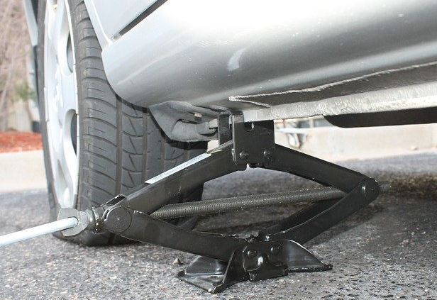
Self-Locking Screws
If the friction force is not sufficient to prevent this sliding, the nut will turn on its own, lowering the load quickly.
Public Domain Image by Daderot
Public Domain Image by nrjfalcon1

Slide 11
Self-Locking Screws
Generally, the nuts are less likely to slip on gentle slopes (small lead angles) while they are more likely to slip on steep slopes (large lead angles.
The dividing point between sliding and not sliding is defined by the self-locking angle.
lead angles below this will be self locking (they will not slip if released)
lead angles above this will not be self locking (they will slip if released)

Slide 12
The Self-Locking Angle
To find the self-locking angle, we will...
assume impending motion.
Draw a free body diagram with an unknown angle
Write out the equilibrium equations
Solve for the unknown angle.
$$F_{load}$$
$${μ_{s}∗F}_{N}$$
$$θ_{locking}$$
$$F_{N}$$
$$θ_{locking}$$

Slide 13
The Self-Locking Angle
$$\sum{F_{X}=−F_{N}∗\sin\left(θ\right)+μ_{s}∗F_{N}∗cos⁡(θ)}=0$$
$$F_{load}$$
$$\sum{F_{y}=−F_{load}+F_{N}∗cos\left(θ\right)+μ_{s}∗F_{N}∗\sin\left(θ\right)=0}$$
Using the x equation above, we can solve for theta in terms of the coefficient of friction.
$${μ_{s}∗F}_{N}$$
$$θ_{locking}$$
$$F_{N}$$
$$θ_{locking}$$
$$θ_{locking}=\tan^{−1}{(μ_{s})}$$

Slide 14
Thanks for Watching
See other engineering mechanics videos and access the full tool at…

Slide 15


Power Screws Worked Example
The power screw below is being used to lift a platform with a weight of 12 pounds. Based on the information below...
What is the torque on the shaft required to lift the platform?
If the torque were released, would the platform begin to fall?
Diameter of Screw = .375 in
Threads per inch = 12
$$μ_{s}=.16$$
$$μ_{k}=.16$$

Slide 16
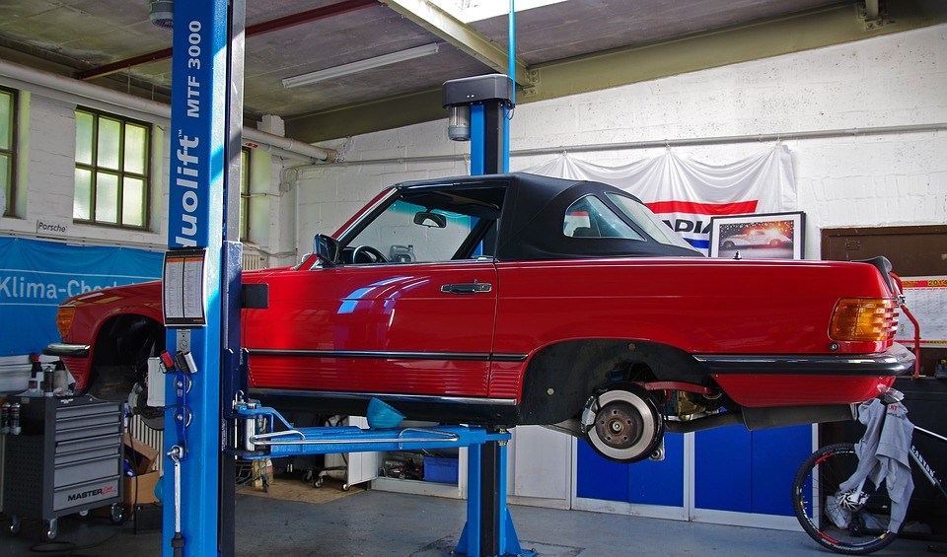


Power Screws Worked Example
You are designing a screw lift system that will be used in auto repair shops as shown below. Each screw lift will be required to support loads up to 20kN.
Assuming a coefficient of friction of .2, what is the maximum lead angle such that the system will be self-locking?
Assuming a 5cm diameter screw, and an available motor torque of 60Nm, what is the maximum pitch that could be used to lift the 20kN load?
$$μ_{s}=.2$$
$$μ_{k}=.2$$

